Slide 1
Dev of Web-based Key Manager Encrypted Equipment Resources James Park Operations Coordinator, COE parkjc@hawaii.edu

Slide 2
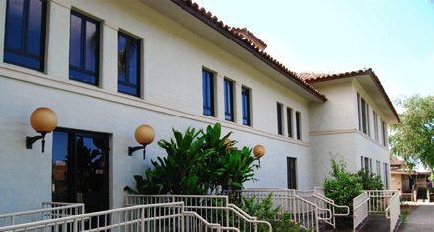
Introduction
University of Hawaii at Manoa – College of Education
Approximately 230 computers encrypted in the College of Education
Encompasses all operating systems (OS X, Windows, Linux)

Slide 3
Cause
Required to encrypt computers for sensitive data (PII)
Needed a way to store encryption keys in case of any encryption malfunctions
An efficient way to search for specific users to see their computer information

Slide 4
Effect
Developed a web based encryption site for an organized way to manage encrypted users
Stored encryption keys in a separate server accessible via VLAN behind firewalls
Provide statistical analysis of what OS users are using most

Slide 5
Implementation
Written in Javascript, HTML, CSS
Back end written in PHP
Encryption algorithm used to mask sensitive information (i.e. MAC addresses) inside the database

Slide 6
Future Implementations
Use a framework to have better organization
Make the code open-source

Slide 7
Thank you

